Slide 1
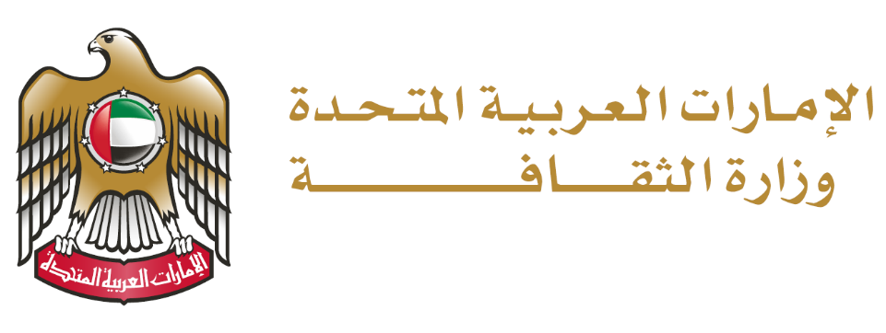
أهداف التنمية المستدامة
SDGs

Slide 2
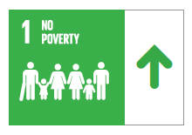
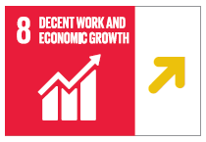
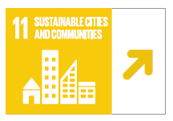
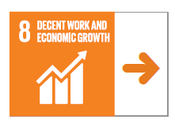
Achieving Sustainable Development Goals is a Top Priority for Our Collaboration with Local and International Partners
SDG DASHBOARDS AND TRENDS IN UAE
2021
Cultural Sector
SDGs
2023
1100
405,875
38,527
97.8%
65%
100%
Number of jobs created through the Mosul Spirit Revival Initiative
Number of people working in Cultural & Creative Industries
Number of Establishments Working in the Creative Field
1st Arab World
10th Globally
National Identity Indicator
Percentage of Joint Declaration Launch for Cultural Heritage Protection by Ministries of Culture (33 Countries)
MOC KPIs & Initiatives
4.02%
Number of Intangible Cultural Heritage Elements at UNESCO
Percentage of cultural sites in the country prepared to deal with climate change effects
The contribution of cultural and creative industries activities to the UAE GDP
Develop the National Identity Strategy
Launch the First Edition of the National Register of Architectural Heritage
Launch a Funding Program to Encourage Research and Studies in the Field of Modern Heritage
African Cultural Heritage Protection Program
Register Heritage Elements as part of the World Heritage List
Prepare a Draft Resolution on Climate Change ad Cultural Heritage and Submitting it to the UNESCO Executive Board
Convene A Meeting Of Ministers Of Culture to Discuss and Declare an Alliance Calling for the Integration of Culture into Climate Action
African fund for preservation of heritage
Mosul Spirit Revival Program
Design and Launch the National Grants Program for Culture and Creativity
Creative UAE Statistics

